Slide 1
Graphs and Social Networks
19Z302 – Data Structures and Algorithms
Sreeraghavan R
22Z261

Slide 2
Introduction

Slide 3
Introduction
Social Networks, in essence connect all its users through some network, such as friends, followers or communities
This network consists of users who are constantly manipulating their local networks, adding and removing connections

Slide 4
Why Graphs?
If we consider users to be the central data points, or nodes, we can see that each node is connected to multiple other nodes with no overall pattern in the structure
Because of this, its best to consider a graph data structure to represent this network and its operations

Slide 5
Terminologies
Nodes: They are the central components of graphs and contain actual data
Users: They are the central components of social networks/media and include a large amount of data such as posts and comments
Edges: They represent connections between nodes in a graph

Slide 6
Terminologies
Followers: Followers, friends and other related terms all refer to the connections between users in a social network

Slide 7
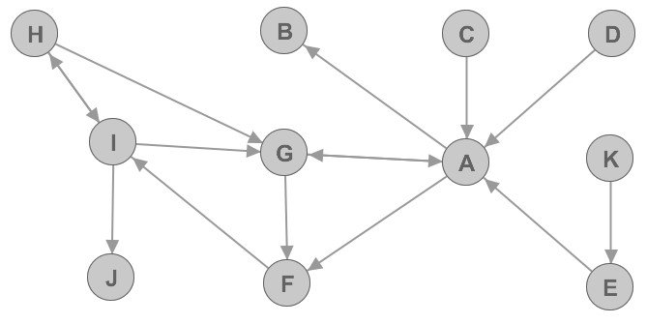
Overall Structure
Each node in the graph represents a user and contains relevant attributes which can change depending on what the graph is used for
Each node is connected to other users and represents a connection such as being friends or followers
Users can be followed by people they do not follow; hence we need to account for the direction of the edge connecting the nodes as well

Slide 8
Overall Structure
An important fact to consider about this structure is that the entire structure rarely needs to considered and only relatively small sections that we can call “communities” are used in most cases

Slide 9
Social Media Operations

Slide 10
Social media Operations
The main product of social networks is the data generated from the users, which is why it is important to maximize retention and find the correct advertisements for them
To do this, multiple operations are done on communities such as
Friendship Networks
Content Personalization
Fraud Detection

Slide 11
Friendship Networks
An important feature of social networks is “mutuals”, users that you and other some other random user both follow. This helps users decide if another user is somebody known to them
The operation to find mutuals is done by simply comparing the nodes that both users follow and can be done by comparing the edges from both nodes

Slide 12
Friendship Networks
Another related feature is “Users you may know”, or the user recommendation algorithm. A simple way to implement this is by taking a user and their related community of other nodes that they interact with and finding all the nodes that they are not directly connected to
This sub-network can differ from just the users they follow to all users they’ve interacted with or users who interact with similar content
A “mutualness” score can also be assigned to these nodes by the number of “friends” who are connected with that node, to further provide better recommendations

Slide 13
Example
In this graph, the nodes G and F are mutual nodes of A and I

Slide 14
Content Personalization
Advertisements work better when they are targeted at users who would be receptive to them. To find if an advertisement will work on a user, we require data on existing users’ interactions with ads
With that information, we can add users to a “RespondWellToAD” graph and compare the individual nodes and their communities to find if certain communities exist in that graph, in which case it is reasonable to assume the ad works on the entire community and can be shown to anyone who is a part of it.

Slide 15
Representation

Slide 16
Representation
There are multiple ways to represent a graph such as Adjacency Matrices, Lists, Sets or Hash Maps
A large social network such as Facebook or Instagram most likely uses a custom structure that works best for their case
However, through the operations that are allowed, we can make assumptions about the structure they use

Slide 17
Representation
We know that there are millions of users for these platforms and that a non-negligible number of accounts are inactive and don’t generate any data
In a matrix representation, these users will occupy a large amount of space that is essentially wasted

Slide 18
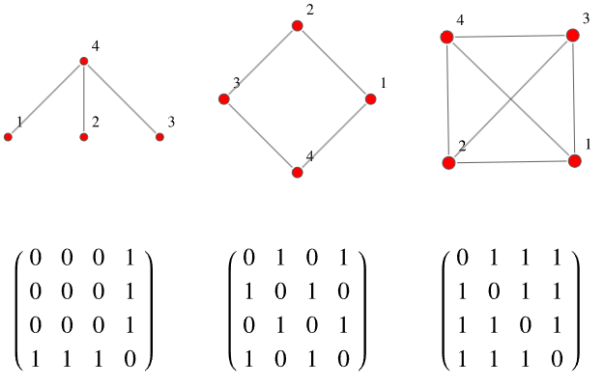
Adjacency Matrix
Each 1 represents an edge between the nodes represented by that particular index
While an adjacency matrix is useful in the third case, from the first it is visible that a large amount of space exists without providing any information

Slide 19
Representation
This wasted space is prevented by using an adjacency list as only the edges are represented and that is a more useful representation of the nodes as users.
However, in a List representation, operations such as searching for a specific user or connection can be O(n) compared to a matrix where due to its random-access capabilities, it would be almost instantaneous to check if an edge exists between any two nodes

Slide 20
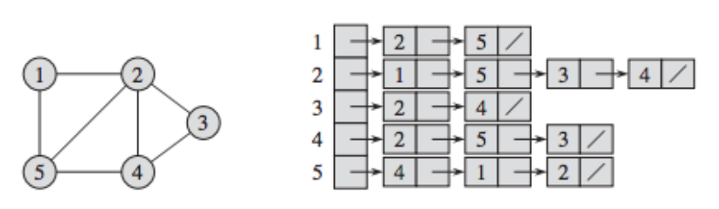
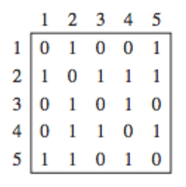
Adjacency List
In this structure, only the edges are represented as nodes on the linked lists
This saves a large amount of space compared to the matrix representation, especially as the number of nodes reaches millions, with only a few hundred connections per node (sparse network)

Slide 21
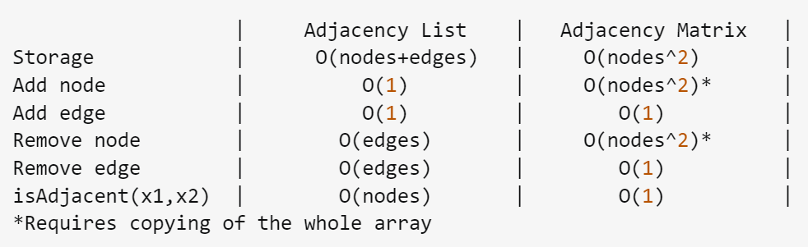
Comparison

Slide 22
Representation
As an alternative, we can use the Hash Map representation where nodes are represented as keys and the values are another data structure that contains the edges the node is a part of
This secondary structure can be anything such as a set or another Hash Map
A Hash map of Hash Maps would be an ideal structure as searching for a single edge becomes an O(1) operation
For other operations such as analysing a sub-network or community, the complexity would degrade to list or set levels

Slide 23
Conclusion
Graphs are the best way to represent networks like these that have no rules in their connections
They can be represented in multiple ways and each representation has its own benefits
Ultimately, the exact representation depends on what the developers decide is more important and has to occur at higher speeds

Slide 24
References
Stackoverflow (complexity analysis)

